Slide 1
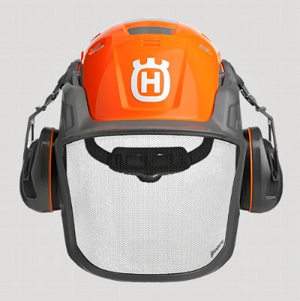



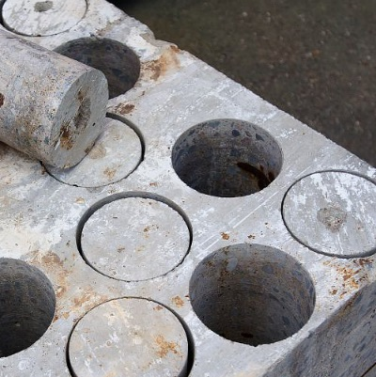


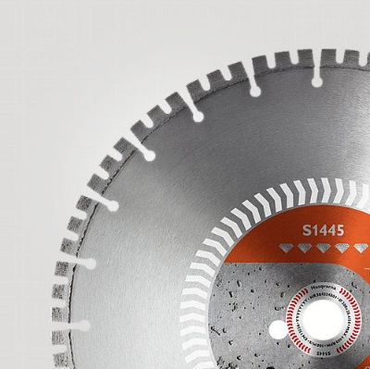
Infrastructure Transformation - Global Cutover Planning
24th of November, 2017

Slide 2
Cutover Planning Nov - Jan Sweden
DC | No | Location | Service Cutover | Start Time (Local) | End Time (Local) | Service Window* | Downtime Required | Remark
Sweden | 1 | Invid DC | INVID MPLS & Internal Firewall Cutover | Nov 25, 2017 16:00 CET | Nov 26, 2017 02:00 CET | 10 Hours | 4 Hours (Including roll back) | Confirmed
 | 2 | Invid DC & Huskvarna DC | INVID & Huskvarna Perimeter External Firewall Cutover | Dec 9, 2017 03:00 CET (Dec 8, 6:00 PM PST) | Dec 9, 2017 08:00 CET (Dec 8, 11:00 PM PST) | 5 Hours | 5 Hours (Including roll back) | Weborder is affected, Vancouver (-9H). Coordination with sales team, notification on service windows.
 | 3 | Huskvarna DC | Huskvarna DC LAN Cutover | Dec 9, 2017 16:00 CET | Dec 10, 2017 02:00 CET | 8 Hours | 4 Hours (Including roll back)
 |  |  | Husqvarna MPLS & Internal Firewall Cutover | Dec 10, 2017 16:00 CET | Dec 10, 2017 23:00 CET | 7 Hours | 5 Hours (Including roll back) | REX availability critical in NZ (+12H), Australia (+10H) and Japan (+8H), mitigation activities are required. Production availability in Sweden
 | 4 | Invid DC & Huskvarna DC | INVID & Huskvarna DR Testing | Dec 27, 2017 18:00 CET | Dec 28, 2017 02:00 CET | 8 Hours | 3 Hours | Confirmed by Finance and Production Huskvarna
 | 5 | Huskvarna site | Replacement of core layer, HKV remote site | Dec 2, 2017 18:00 CET | Dec 2, 2017 23:00 CET | 5 Hours | 3 Hours | Impact network from inside Huskvarna location
 | 6 | Huskvarna site | Building 601 floor 3, refresh distribution and access layer | Dec 11, 2017 18:00 CET | Dec 11, 2017 22:00 CET | 5 Hours | 3 Hours | Check if room 604 (high storage) is affected
 | 7 | Huskvarna site | Building 601 remaining, refresh distribution and access layer | Dec 13, 2017 18:00 CET | Dec 13, 2017 22:00 CET | 5 Hours | 3 Hours | Check if room 604 (high storage) is affected
 | 8 | Huskvarna DC | Dry run JDE EMEA/APAC | Dec 15, 2017 17:00 CET | Dec 17, 2017 18:00 CET | 49 hours | 49 hours
 | 9 | Huskvarna DC | Go Live JDE EMEA/APAC | Jan 12 XX CET | Jan 14 XX CET | 50 Hours | 50 Hours
* include execution, test and roll-back, if needed

Slide 3
Draft Cutover Planning Nov - Jan USA & Germany
DC | No | Location | Service Cutover | Start Time (Local) | End Time (Local) | Service Window* | Downtime Required | Remark
USA | 10 | Winston-Salem & Kannapolis | DC Inter-link cutover (WS-KNP) for LPAR (Huskey) replication | Nov 18, 2017 XX:XX AM EST | Nov 18, 2017 XX:XX PM EST | 3 Hours | 1 Hours (including roll back) | iSeries project
 | 11 | Winston-Salem | Huskey migration from P7 to P8 and V7K to V9K | Nov 19, 2017 00:00 AM EST | Nov 19, 2017 05:00 PM EST | 17 Hours | 15 Hours (Including roll back) | iSeries project
 | 12 | Winston-Salem | Winston-Salem DC LAN Cutover | Dec 2, 2017 1:00 PM EST | Dec 3, 2017 00.30 AM EST | 11,5 Hours | 4,5 Hours (including roll back) | Confirmed by Finance
 | 13 | Winston-Salem | Winston-Salem DC MPLS WAN & Internal Firewall cutover | Dec 3, 2017 11:00 AM EST | Dec 4, 2017 00:30 AM EST | 13,5 Hours | 5,5 Hours (including roll back) | Confirmed by Finance
 | 14 | Winston-Salem & Kannapolis | Winston-Salem DC Internet & Perimeter Firewall cutover | Dec 4, 2017 8:00 PM EST Dec 22, 2017 00:00 EST | Dec 5, 2017 5:00 AM EST Dec 23, 2017 9:00 AM EST | 9 Hours | 5 Hours (Including roll back) | .
Germany | 15 | ULM DC | ULM DC LAN & Internal firewall cutover | Nov 18, 2017 14:30 CET | Nov 18, 2017 17:30 CET | 3 Hours | 3 Hours (including roll back) | Confirmed
 | 16 | ULM DC | Internet & DMZ Service (external perimeter cutover) | Nov 18, 2017 17:30 CET | Nov 18, 2017 22:30 CET | 5 Hours | 3 Hours (incl. roll back) | Confirmed
* include execution, test and roll-back, if needed

Slide 4
Global Cutover Timeline – Activities & Available Windows
10
11
12
13
8
9
Winston-Salem DC
LPAR replication
Husky migration
Winston-Salem DC
LAN
Internal firewall
Huskvarna DC
Dry run JDE
Huskvarna DC
Go live JDE
1
2
3
Invid (Sweden)
MPLS
Internal firewall
Huskvarna DC
Internal firewall
Perimeter firewall
Nov 18-19
Nov 25-26
Dec 2-3
Dec 9-10
Dec 16-17
Dec Holidays
Jan 6-7
Jan 13-14
Jan 20-21
Jan 27-28
15
16
5
14
6
7
14
Ulm DC
Internal firewall
Perimeter firewall
Huskvarna Site
LAN
Dec 11 & 13
Huskvarna Site
LAN
Winston-Salem DC
DC Internet
Perimeter firewall
4
Dec 27
Huskvarna DC
DR Testing
Available service window Optional windows
Notes:
embr

Slide 5
End User Impact in DC locations
Task | End User Impact
Huskvarna MPLS & Internal Firewall Cutover | All Services hosted in Huskvarna DC will be shut down or have intermittent disturbance in the Network during the maintenance window Direct Impacted services: REX, JDE (Europe, Asia, Australia, South Africa), PRISME (France), PRMS (UK), Weborder (Global), Local application (HQV) Domino (Global),
Invid MPLS & Internal Firewall Cutover | All Services hosted in Invid DC LAN will be shut down or have intermittent disturbance in the Network during this maintenance window Direct Impacted services: Edge (Local), DW (Global), Logility, Smart plant, Local application (HQV), Smart-team (main site), Citrix (WP), IScala (Baltic), Finance Stockholm, University (Global), LocalaIT (UK), Dynamic CRM, Mapping/Showcase/IBS (France), CATIA (Global)
Invid & Huskvarna Perimeter Firewall | Internet and DMZ services hosted in both Invid & Huskvarna DC will be shut down or have , intermittent disturbance,
Invid/Huskarna DR testing | All services hosted in both Invid & Husqvarna DC will be shut down or have intermittent disturbance Direct Impacted services: All above in task 2 and 3

Slide 6
End User Impact in USA DC locations
Task | End User Impact
Winston Salem DC LAN cutover | All Services hosted in Winston Salem will have complete or intermittent distrubtion in the Network during this maintenance window. Direct impacted service :- Husky, CRM, SQL/Lotus, (WebSphere 6.1.27) Nfe Production, Sterling EDI server for Husky400, NFE Production, JDE 9.1 Production, Becomex Production, Citrix XD & StoreFron t, FedEx Production Ship, Smartteam, MAXLOAD PRO, API ECOMMERCE e DBMOTO Production, TST REX / VARSITY 1, Supplier EDI project, Infolox, AS400TGT, GRAFTON
Winston Salem MPLS & Internal Firewall Cutover | All Services hosted in Winston Salem will have complete or intermittent distrubtion in the Network during this maintenance window. Direct impacted service :- Husky, CRM, SQL/Lotus, (WebSphere 6.1.27) Nfe Production, Sterling EDI server for Husky400, NFE Production, JDE 9.1 Production, Becomex Production, Citrix XD & StoreFron t, FedEx Production Ship, Smartteam, MAXLOAD PRO, API ECOMMERCE e DBMOTO Production, TST REX / VARSITY 1, Supplier EDI project, Infolox, AS400TGT, GRAFTON
Pls refer attached Application name, Server and owner list for impacted service.

Slide 7
Network & Security Cutover – Why & What
Why are we doing this?
Remove SPOF in the DC setup
Implement additional capacity and redundancy
Implement additional security services and prepare for additional security services
Prepare for a Disaster Recovery Solution for more applications
In the case of a disaster, defined applications will have the possibility to run on a second setup of servers. This means the impact on the business will be minimized. On Gold level the recovery is done at the very instant of the outage or within minutes
What are we doing?
Network & Security cutover includes task - and - . During the cutover the following will be connected:
Multiprotocol Label Switching (MPLS) – the communication between remotes sites and data centre
Perimeter Firewall - our first line of defense against external attacks and also blocking access to inappropriate content from inside the organization
Internal firewall – the firewall to our internal network
Disaster Recovery Solution (DR)
1
4
10
16

